Slide 1
Extending an Integrated Computational Model of the Time-Based Resource-Sharing Theory of Working Memory
Joseph Glavan Joseph Houpt
Wright State University
May 12, 2018

Slide 2
Working Memory
Commonly thought of as a store or sketchpad for holding and modifying information
Notes:
The topic of my talk is working memory. I think we all have a general idea as to what that is. It is commonly thought of as a store or sketchpad for holding, and potentially manipulating, information over short periods of time.

Slide 3
Time-Based Resource-Sharing
WM is an active mechanism
Focuses attention on a single item for maintenance or processing
Focused item gains strength (activation)
All other items decay with time
More time for maintenance = more information retained
Less time for maintenance = less information retained
Barrouillet, Bernardin & Camos (2004)
Notes:
However the time based resource sharing, or TBRS, model, which I will talk about today, instead proposes that WM is an active mechanism that focuses attention on a single item at a time for either maintenance or processing, and this focused item gains strength or activation which makes it more likely to be recalled later.
Now, anything that is not currently in the focus of attention undergoes temporal decay and becomes harder to recall.
This means that the more time you have to use attention for maintenance, the more information that can be retained; whereas the less time time you have for maintenance, because attention is needed elsewhere, the less information that will be retained.

Slide 4
Dual Task Paradigm
Maintenance
Processing
Episodic encoding
Attentional refreshing
Articulatory rehearsal
Attend to distractors
Retrieve necessary knowledge
Choose response
W | 7 | 9 | 6 | 6 | N | 8 | 2 | 2 | 7
S | 5 | 6 | 2 | 7 | L | 9 | 5 | 3 | 2
Notes:
Now let’s consider the dual task paradigm that is commonly used to study WM. You’re typically required to remember a list of some kind, in this case letters, while performing some distracting task, in this case reporting whether a number is odd or even. ((Example))
If we want to predict how much of the list will be recalled at the end, according to TBRS we need to consider how much time was available for maintenance. Now in practice it is often easier to consider how much time was unavailable for maintenance. In this case we can take a set of letters and treat the RT to each letter as a proxy for the distractor’s processing time. If we add up the RTs over a certain period of the task, we can calculate the total processing time.

Slide 5
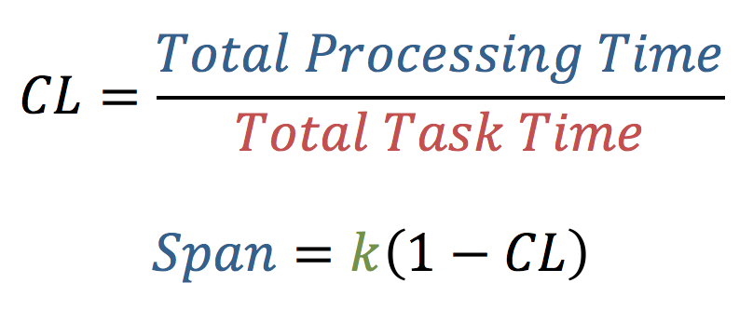
Cognitive Load
k = raw WM capacity (unique to individual, task, etc.)
Barrouillet, Portrat & Camos (2011)
Notes:
And if we divide the total processing time by the total task time, we get a proportion called cognitive load. TBRS predicts that observed WM span, or essentially the average number of items recalled, is a linear function of this CL.

Slide 6
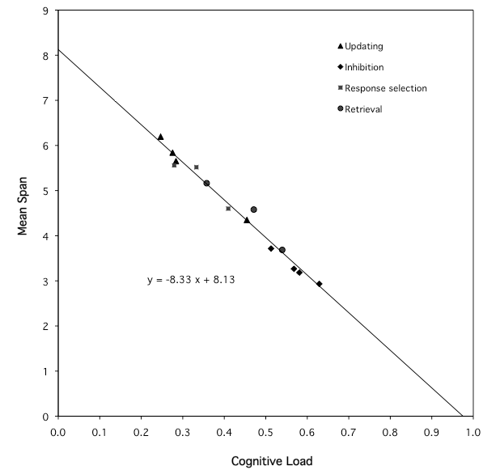
Y = -8.33 * X + 8.13
R² = .98
Barrouillet, Portrat & Camos (2011)
Notes:
Barrouillet, Camos, and colleagues have repeatedly demonstrated this linear function using a variety of distractor tasks. This figure here comes from a meta-analysis of 14 different conditions. What’s important is that this figure shows that the type of distractor task doesn’t affect how much information is retained, rather it is the temporal dynamics of the task that are important.

Slide 7
TBRS Is Underspecified
Does not describe distractor task
Performance is the interaction of maintenance and processing activity
Limited range of CL tested with humans
Is this function really linear?
Notes:
Now that I’ve shown you evidence for the TBRS model, I want to talk about way in which it is underspecified, which I will address later in the talk.
The first shortcoming of TBRS is that it does not describe exactly how the distractor task is to be completed. This may seem to specific for what is supposed to be a model of memory, but TBRS says that overall performance is the result of interactions between maintenance and processing. So the processing demands can affect what you remember, and the memory demands can affect your processing strategy. In order to have a complete theory of WM, we need to have a model that addresses the entire task, not just the memory component.
The second issue with TBRS is that if we look at the range of CL that has been tested with humans, it has been rather limited to the middle of the continuum. This is a problem because the hypothesis is that the relationship between span and CL is linear.

Slide 8
?
?
Barrouillet, Portrat & Camos (2011)

Slide 9
TBRS Is Underspecified
Does not describe distractor task
Performance is the interaction of maintenance and processing activity
Limited range of CL tested with humans
Is this function really linear?
Does not describe how attentional refreshing and articulatory rehearsal interact
Evidence for rehearsal as something “extra” above & beyond refreshing, but how so?
Camos & Barrouillet (2014)
Notes:
My last point is that many theories of WM have proposed a specialized verbal mechanism for articulatory rehearsal. Think Baddeley’s phonological loop. Camos and Barrouillet have begun studying how such an ability allows you to remember more information than can be explained by attentional refreshing alone, but the exact nature of the interaction between these two mechanisms has yet to be formalized.

Slide 10
TBRS Is Underspecified
Does not describe distractor task
Performance is the interaction of maintenance and processing activity
Limited range of CL tested with humans
Is this function really linear?
Does not describe how attentional refreshing and articulatory rehearsal interact
Evidence for rehearsal as something “extra” above & beyond refreshing, but how so?
Build a computational process model using ACT-R
Simulate greater/lesser distractor pacing and “artificial” cognitive load
Use ACT-R’s architectural constraints to suggest potential methods of coordination
Anderson (2007)

Slide 11
Attentional Refreshing
A
B
C
D
E
Glavan (2017)
Notes:
A is recalled first because we use the head as a cue
Using A as the next cue, both A and B are close in episodic similarity, but A is inhibited
Using B as the next cue, A B C are similar in time, but B is heavily inhibited and A was more recently retrieved than C so it is penalized

Slide 12
Simulation Results
Notes:
Now let’s look at the results of the model simulations, starting with the attentional refreshing version of the model first.

Slide 13
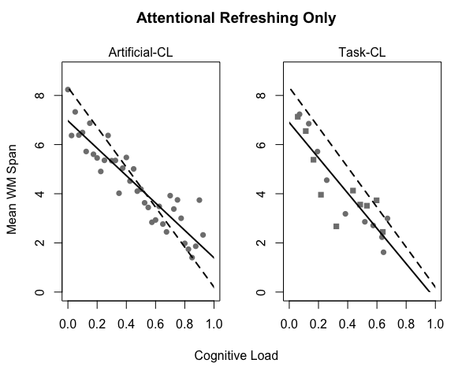
Model
Barrouillet et al. (2011)
Notes:
Here I’m plotting cognitive load on the x-axis and mean WM span on the y-axis. The left panel comes from using my artificial CL – remember that is when I prevent the model from being able to use refreshing for a certain amount of time. The right panel comes from using task-induced CL – that is when the model actually completes a distracting task, in this case parity or spatial judgments. The solid line is the model and the dashed line comes from the human regression that I showed you earlier.
The model does a good job of capturing the linear relationship, and the fit is closer for the task-based CL. Notice also that despite increasing the pace of the distractor task, the model does not produce CL above .7 or so. I’ll return to that in a moment.

Slide 14
Articulatory Rehearsal
Two parallel “loops”
Attentional refreshing (declarative retrievals) reactivates memory traces
Articulatory loop (subvocalizing) operates on auditory representations
When both loops temporally align, auditory representation is used to cue retrieval
Sidesteps the temporal similarity penalty
Notes:
I implement articulatory rehearsal by using two parallel loops: the attentional refreshing loop I just described actually does the work of boosting each item’s activation, while a second, articulatory or phonological loop, operates on auditory representations. This loop repeatedly pulls words the model recently heard from its aural buffer and then silently repeats it to itself, reloading the loop.
Although both loops may take different amounts of time to cycle, when they line up, as in when they both are ready retrieve or vocalize another item at the same time, the auditory representation is used as the retrieval cue for instead of the just-retrieved memory representation. This allows much weaker items to be retrieved because it avoids having to use the temporal similarity penalty.

Slide 15
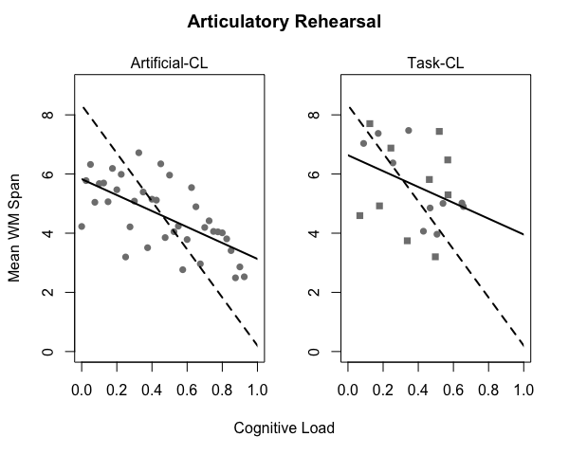
Model
Barrouillet et al. (2011)
Notes:
These are the results for the version of the model that uses articulatory rehearsal. There are two things to note about these figures. The first is that this version of the model is much more variable. The second is that the effect of CL has been reduced.
Another interesting feature of these results is that in the task-based CL condition, the model again refuses to produce CL greater than 0.7. If I color code these figures by the pace of the distractor task…

Slide 16
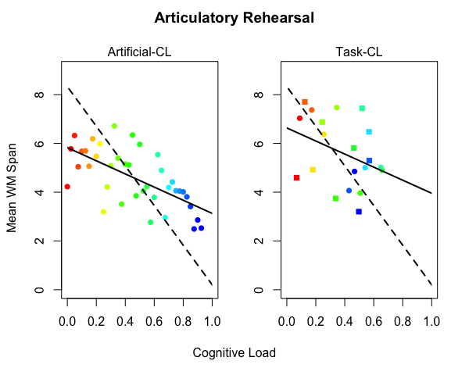
Model
Barrouillet et al. (2011)
Notes:
…so that the pace and therefore CL increases as the colors get colder, we can see that unexpectedly the fastest paces are not the furthest to the right, meaning that they do not yield the highest CL. What’s happening is that the model learns that it cannot reliably respond quick enough in this high-paced condition and begins to use a less accurate but faster strategy. What’s great is that the linear relationship between span and CL seems to still hold despite this change in strategy.

Slide 17
Discussion
Support for linear function with attentional refreshing-only version of the model
Model suggests articulatory rehearsal may reduce effect of cognitive load
Relationship is robust to strategy change
Task-induced CL appears to constrain WM span more strongly than artificial method
What happens during periods of CL may matter
Distribution of CL within task may matter
Notes:
In summary, our model provides support for the hypothesis of a linear relationship between WM span and CL, at least for the attentional refreshing mechanism.
The articulatory rehearsal version of the model also appears to predict a linear function, although the greater variance leaves this conclusion tenuous for the time being.
We also just saw that the model continues to predict this linear relationship despite shifts in distractor processing strategy.
We found some indication that the effect of CL is stronger when the model completes a distractor task compared to when it is simply locked out during the artificial CL condition.
This may be because when completing a distractor task the model is firing other productions instead of just waiting around.
It may also be because during the distractor task, each distractor, and thus each period of CL, is distributed evenly throughout the task, while during the artificial load condition if say 50% CL was desired, then the model was forced to be idle for the first half of the period and free the second half.
We plan to investigate these potential explanations in future iterations of the model.

Slide 18
Conclusion
Extended our earlier work on the attentional refreshing version of the model
The nature of the articulatory rehearsal mechanism remains underspecified
Trouble with suppression tone
Further work needed to identify alternatives
Computational model can make predictions for alternative rehearsal mechanisms that can be tested experimentally
Notes:
In conclusion, we extended our earlier work with the attentional refreshing version of the model by exploring a larger extent of CL and by incorporating an articulatory rehearsal mechanism. The increased variability in WM spans caused by this rehearsal mechanism is surprising and suggests that it requires further refinement. Additionally, I’ve played with adding articulatory suppression to the model and found that it has some trouble, so we need to take a look at whether there are alternative methods to solve the problem. The good news is that because we are asking these process level questions within a computational model, we can use the model to establish the predictions of alternative methods and then identify the critical experiment needed to discriminate among them.

Slide 19
Questions?
Anderson, J. R. (2007). How can the human mind occur in the physical universe? Oxford University Press.
Barrouillet, P., Bernardin, S., & Camos, V. (2004). Time constraints and resource sharing in adults' working memory spans. Journal of Experimental Psychology: General, 133(1), 83.
Barrouillet, P., Bernardin, S., Portrat, S., Vergauwe, E., & Camos, V. (2007). Time and cognitive load in working memory. Journal of Experimental Psychology: Learning, Memory, and Cognition, 33(3), 570.
Barrouillet, P., Portrat, S., Camos, V. (2011). On the law relating processing to storage in working memory. Psychological Review, American Psychological Association, 118 (2), pp.175-92.
Camos, V., & Barrouillet, P. (2014). Attentional and non-attentional systems in the maintenance of verbal information in working memory: the executive and phonological loops. Frontiers in Human Neuroscience, 8, 900. doi:10.3389/fnhum.2014.00900
Glavan, J. J. (2017). Exploring the Time-Based Resource-Sharing model of working memory through computational modeling. (Unpublished master’s thesis). Wright State University.

Slide 20
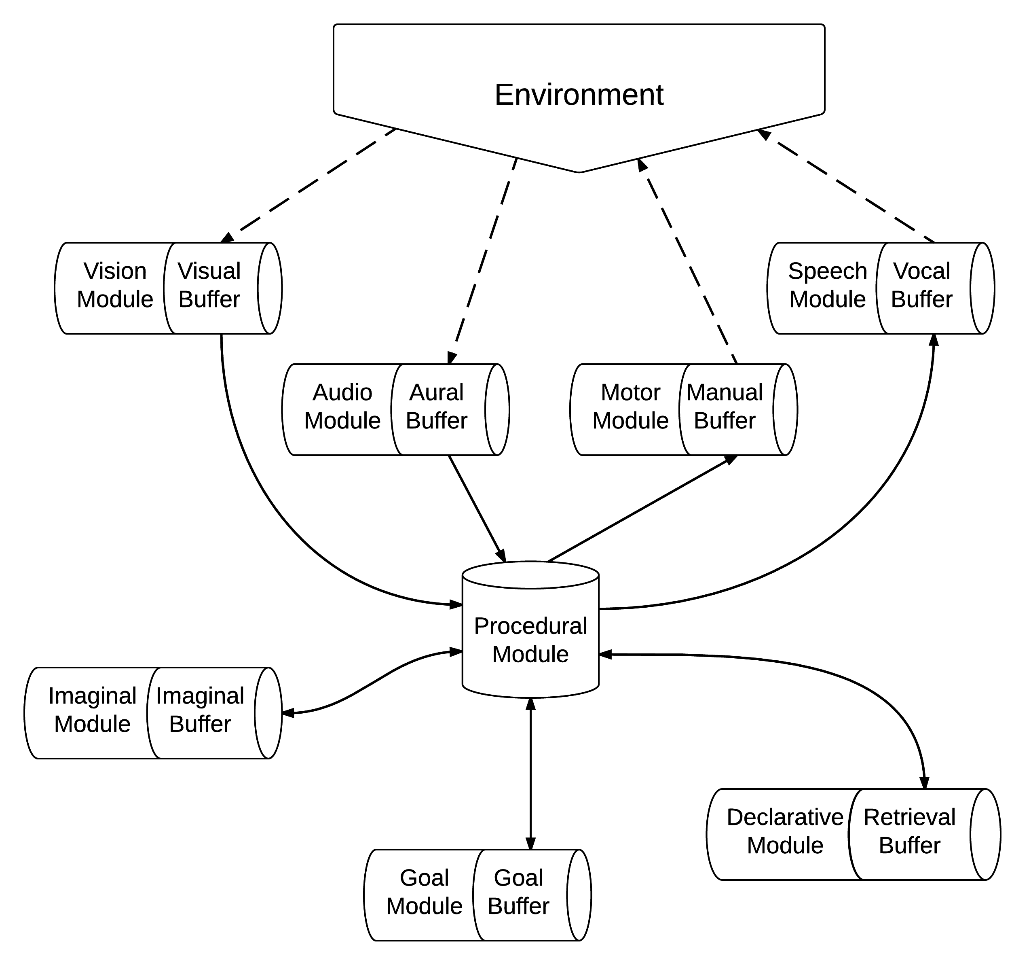
ACT-R

Slide 21
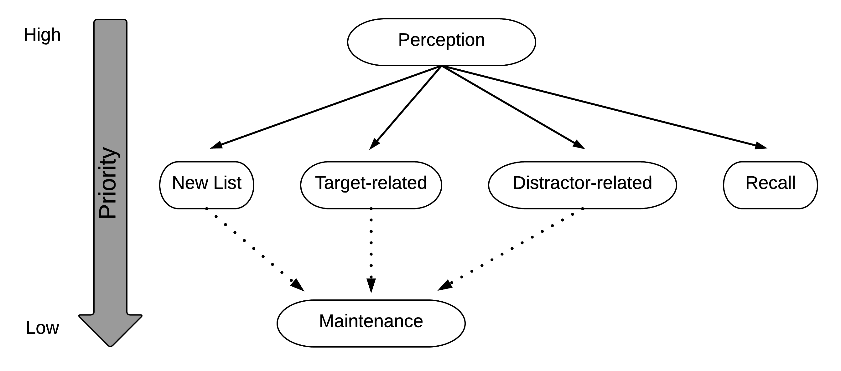
Model Behavior
Notes:
ACT-R is the domain, this is what is going on in the domain
Make it clear this is what I did
----- Meeting Notes (3/27/17 16:39) -----
Add the word "Background" in top left corner then change to "Current Work" or something to designate this is what I did

Slide 22
Parity Condition
Finish Encoding Number
Blind Guess Odd
Blind Guess Even
Retrieve Parity
Guess Odd
Guess Even
Retrieve Response Rule
Guess Odd
Guess Even
Respond According to Response Rule

Slide 23
Spatial Location Condition
Finish Encoding Number
Blind Guess Odd
Blind Guess Even
Guess Odd
Guess Even
Retrieve Response Rule
Respond According to Response Rule

Slide 24
Articulatory Rehearsal
If bottleneck is open, make a fresh retrieval
Continued Refreshing
If nothing in Aural buffer, then make another retrieval and
If Vocal module is free, then subvocalize the current item
If Aural buffer is full and Vocal module is free, then
If Declarative module is free then make a retrieval for and subvocalize the item in the Aural buffer
If Declarative module is busy then subvocalize the item in the Aural buffer

Slide 25
The Task
Barrouillet et al. (2007) – Experiment 3
Compared effects of different sources of CL
Distractor pacing
Distractor task type:
Retrievals: Parity (odd/even)
Response selection: Location (top/bottom)
Recall
*
b
7
delay
500 ms
delay
500 ms
Next target
750 ms
1500 ms
6400 ms
Barrouillet, Bernardin, Portrat, Vergauwe & Camos (2007)
Notes:
- HYPOTHESES
Mention feedback
Address timeline on next slide

Slide 26
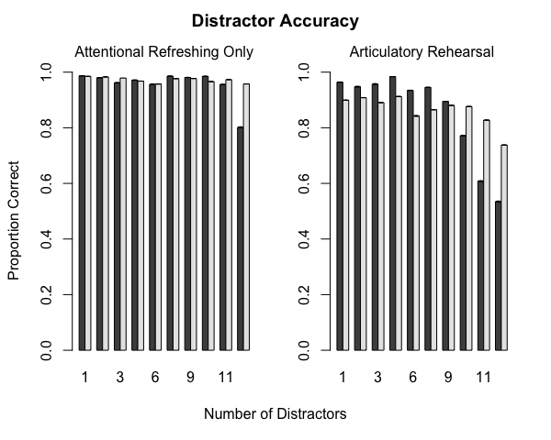

Slide 27
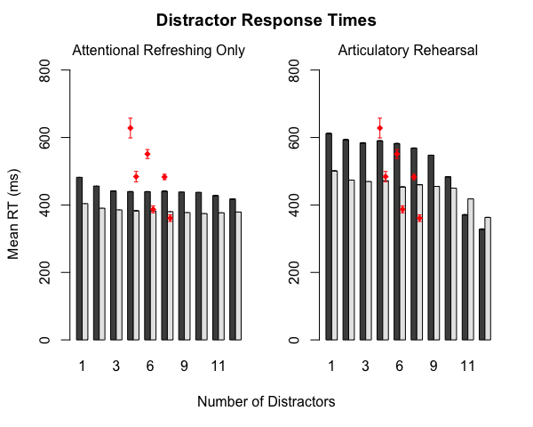
Barrouillet et al. (2007)

Slide 28
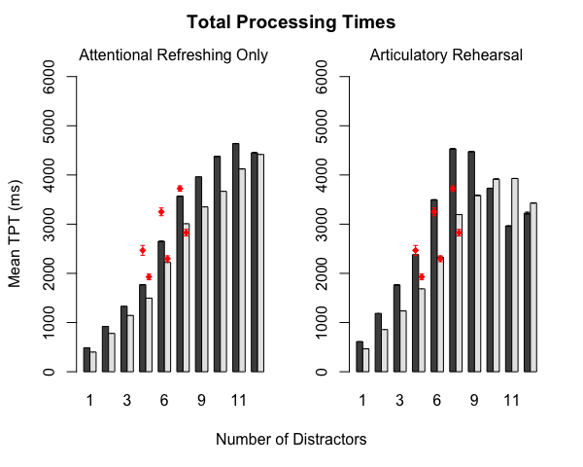
Barrouillet et al. (2007)

Slide 29
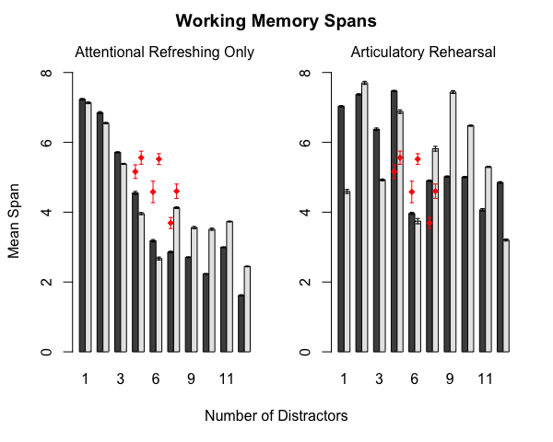
Barrouillet et al. (2007)

Slide 30
Attentional Refreshing
Retrieval Strategy
Request any target
Use just retrieved target as the cue for next request
Episodic Similarity
Association between targets which were encoded under similar temporal-contexts
Temporal Inhibition
Recently retrieved chunks are penalized
Glavan (2017)

Slide 31
Span-CL function appears to hold across changes in strategy

Slide 32
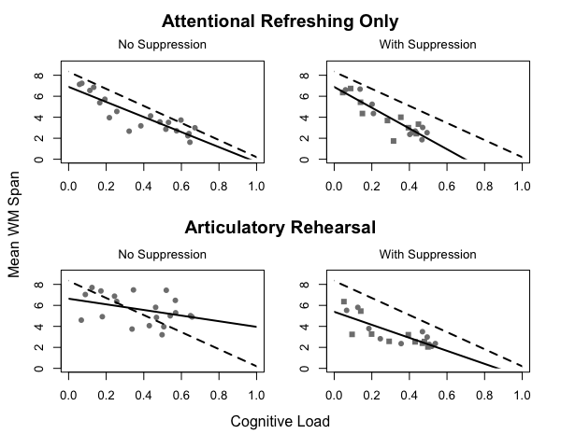

Slide 33
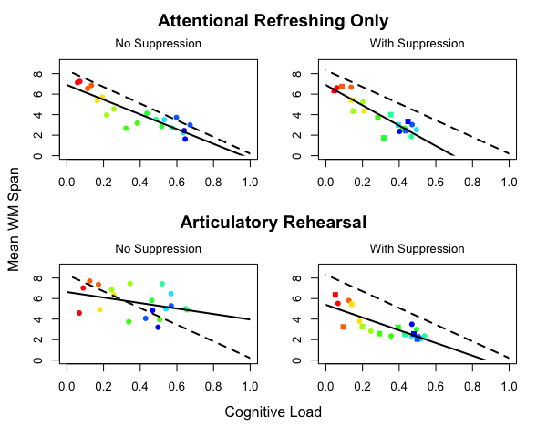

Slide 34
Articulatory Suppression
Additional subtask
Tone is played every 1 second during distractor subtask
When the tone is heard, say “ba”
Articulatory loop misses the tone
May just be an implementation limitation of ACT-R
Need more developed perceptual modules

Slide 35
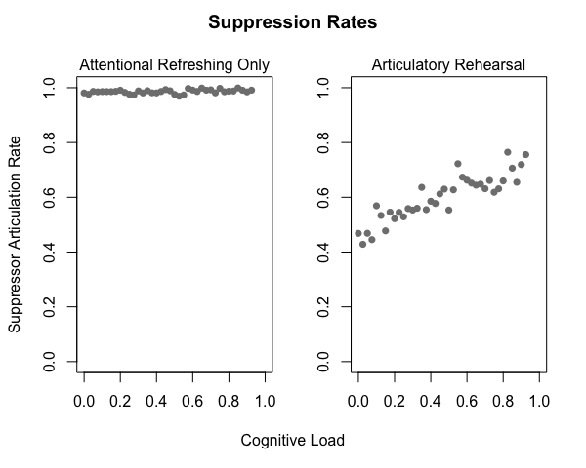

Slide 36
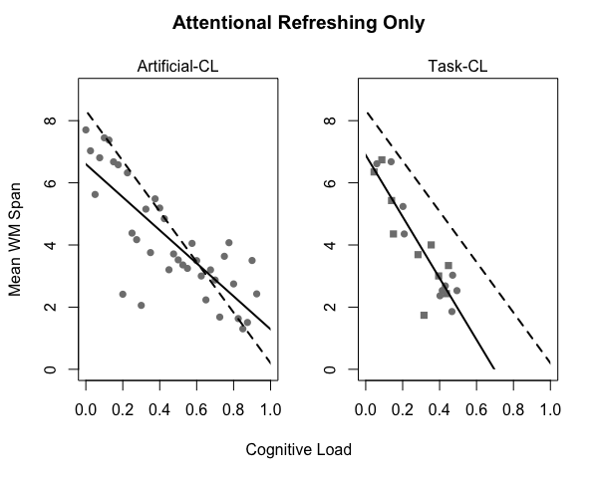

Slide 37
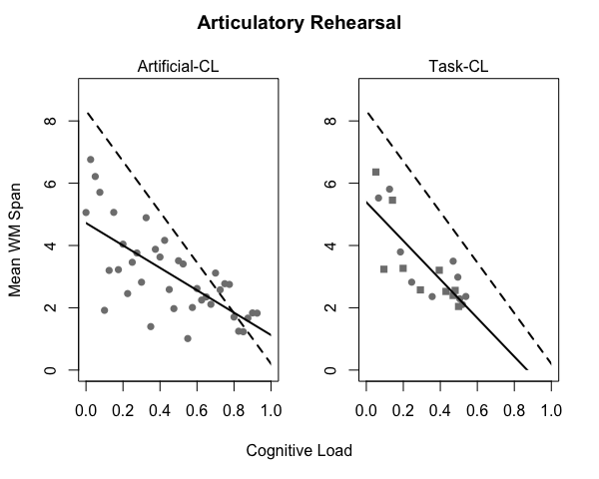

Slide 38
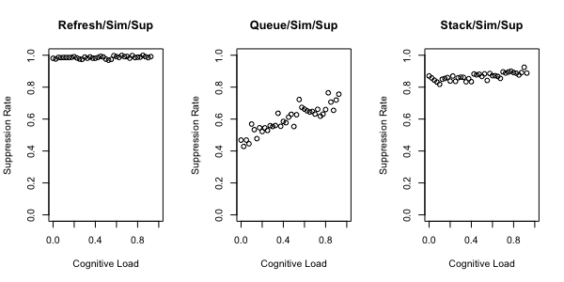

Slide 39
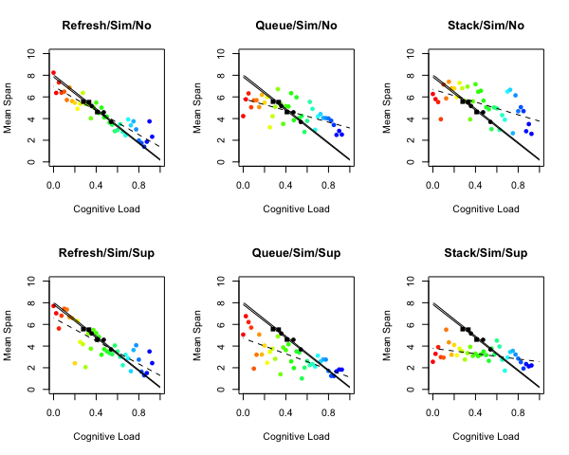

Slide 40
